Slide 1
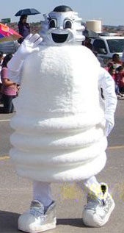
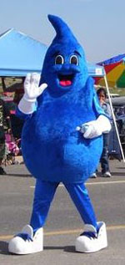
Energy & Water Conservation
Navajo Chapter Technology Conference
March 22, 2018
Presented by Navajo Nation Telecommunication & Utilities

Slide 2
Overview
Utilities Policies
Utilities Costs
Proclamation
Conservation
Bring your Green to Work

Slide 3
Navajo Nation Utilities Policy and Procedures
AUTHORITY:
Pursuant to Health, Education and Human Service Committee Resolution HEHSC-19-17
PURPOSE:
NNTU seeks to provide a safe, comfortable and productive working environment for Navajo Nation government offices by ensuring use of utilities sources to sustain its operation.
To procure utilities service in the most cost effective manner and to promote energy & water conservation.

Slide 4
Navajo Nation Utilities Policy and Procedures
POLICY:
All Navajo Nation divisions, departments/programs are required to request for utilities and other related services through the Navajo Nation Telecommunication & Utilities department who shall procure those services on behalf of the Navajo Nation.

Slide 5
Navajo Nation Utilities Costs
FY’16 FY’17 FY’18*
Electric $3,559,984 $3,441,245 $1,136,869
Natural gas 628,017 647,863 397,039
Propane 895,615 858,926 495,999
Water 592,149 652,437 165,599
Sewage 220,991 211,735 58,758
Total: $5,896,757 $5,812,204 $2,254,263
*As of 3/19/18 per NN FMIS accounting system.

Slide 6
Navajo Nation Proclamation
In 2005, the Navajo Nation Branch Chiefs declared October as “Energy and Water Conservation Month” on Navajo Nation and Encouraging the Dine’ People to do their part in conserving energy and water.
WHEREAS, to promote energy efficiency with an emphasis on reducing energy usage, purchasing energy efficient products and implementing energy conservation measures throughout Navajo Land (Dine’ Bikeyah)
WHEREAS, to promote water conservation with an emphasis on reducing wasteful use and taking steps to reduce unnecessary use by using water wisely

Slide 7
Conservation
All utility services shall be utilized in the performance of Navajo Nation government business and operations.
All departments and programs shall:
Practice and promote energy and water conservation in the workplace.
Report the misuse and abuse of utilities by Navajo Nation governmental personnel to NNTU.
Prohibit utilization of unnecessary appliances in the workplace.
Immediately report – utility outages and breakages to utility service provider and/or NNTU.
Purchase energy efficient office equipment with the EnergyStar logo. For more information go to www.energystar.com.

Slide 8
Bring Your Green To Work
Give it a rest
-Use the ENERGYSTAR power management setting on your computer.
-Use a power strip as a central “turnoff” point to
completely disconnect the power supply
Unplug It
-Unplug electronics such as cell phones and laptops once they are charged. Adapters plugged into outlets use energy even if they are not charging.
Light Up Your Work Life
-Replace the light bulb at your desk with an ENERGY STAR qualified bulb. They last 10 times longer and use about 75% less energy.

Slide 9
Bring Your Green To Work
Turn It Off
-Turn off the lights when you leave, especially at end of the day.
-Turn off all unnecessary lighting
-Turn off office equipment when not in use and at end of the day
Dress for the season
-For productivity, health and comfort, for example, when it is cold wear a sweater in the office verses turning up the thermostat.
Let it Flow
-Keep air vents clear of paper, files, and office supplies. It takes as much as 25% more energy to pump air into the workspace of the vents are blocked.

Slide 10
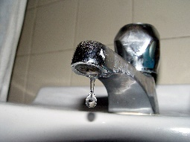
Bring Your Green To Work
Team Up
-Create a Green Team with your co-workers, help build support for energy efficiency in your workplace, and reduce office waste.
More tips, visit www.energystar.gov
Shut it off
Don’t let the water run in the restroom or kitchen
Report It
Any water leaks in building or unexplained water near buildings

Slide 11
Contact Information
Navajo Nation Telecommunication & Utilities
Morgan Boulevard, Building No. 2528
P.O. Box 2928
Window Rock, AZ 86515
Phone: (928) 871-7740
Fax: (928) 871-7741
Website: www.nntu.navajo-nsn.gov

